Slide 1
The Illusion of Online Privacy
Eric Cameron
Associate Professor
Computer and Information Sciences
Passaic County Community College

Slide 2
Agenda
About Me
Online Vulnerabilities
Case Studies
Improving Your Security
Notes:
Teaching for 19 years
4 books for Pearson
Been online since 1993

Slide 3
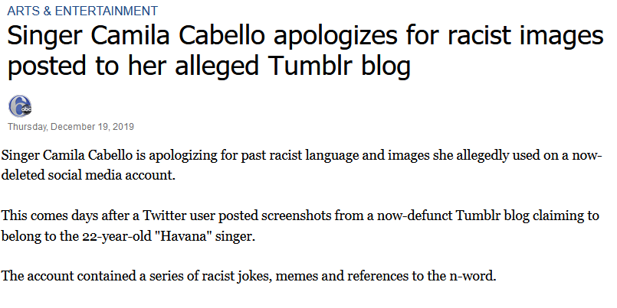

Today’s Online World

Slide 4
How?
Old, forgotten account

Slide 5


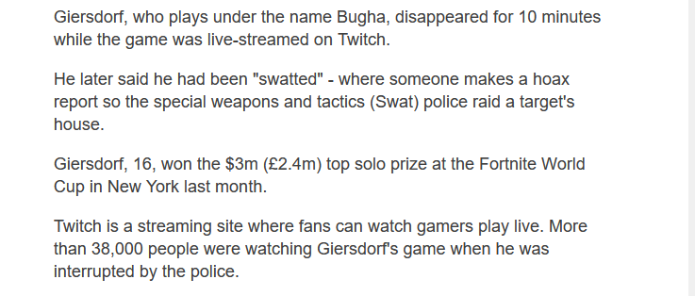
Today’s Online World (Swatting)

Slide 6
How?
Lack of awareness

Slide 7
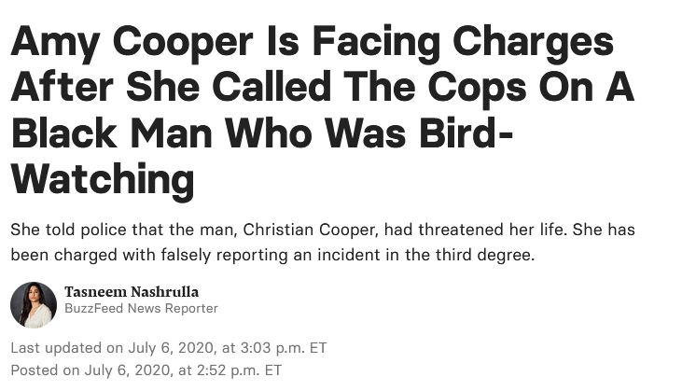
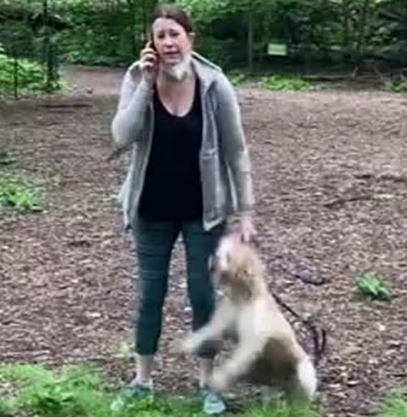
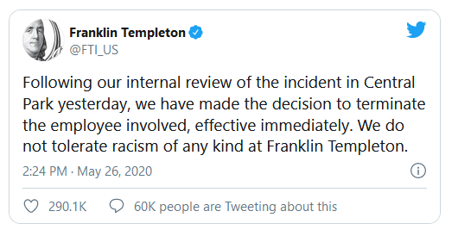
Today’s Online World (Doxxing)

Slide 8
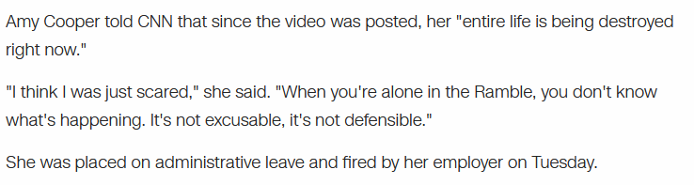
How?
Being a “Karen” and giving the Internet someone to doxx

Slide 9

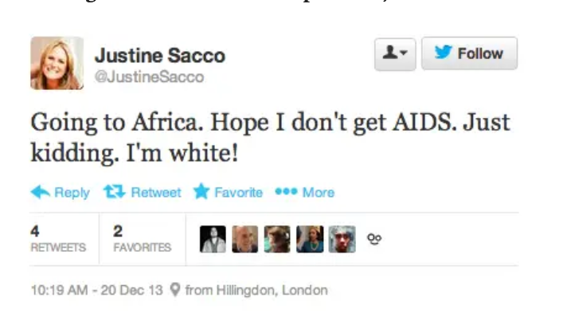
Today’s Online World

Slide 10
How?
Trying to be funny…?

Slide 11
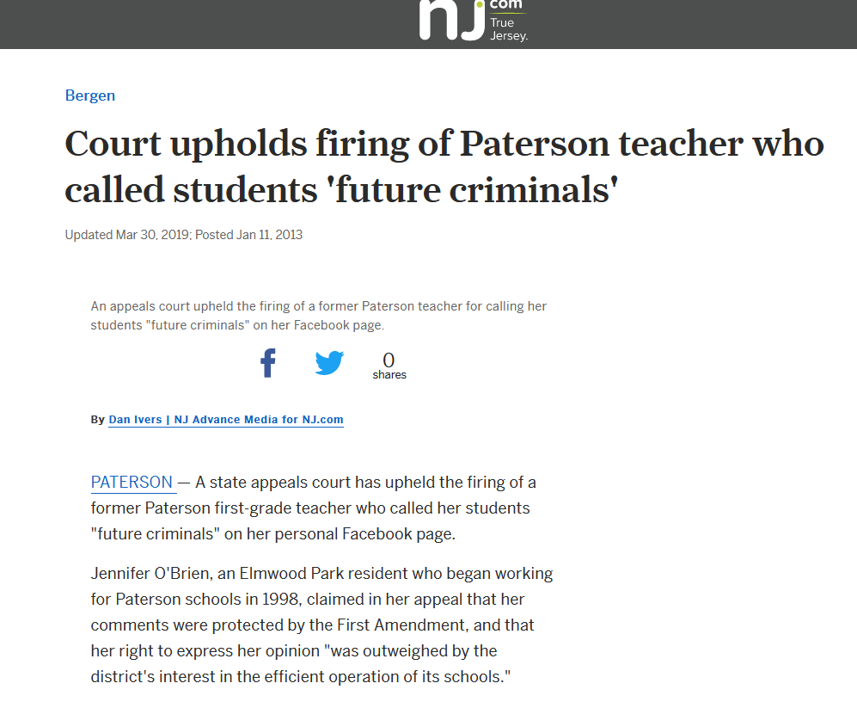
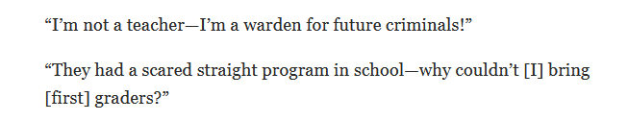
Today’s Online World

Slide 12
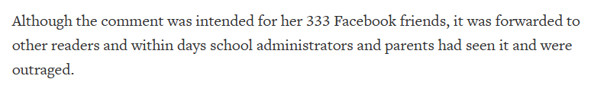
How?
Thinking social media is private

Slide 13
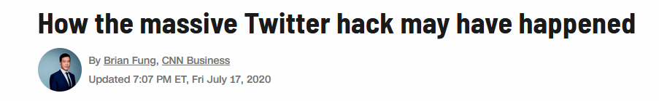
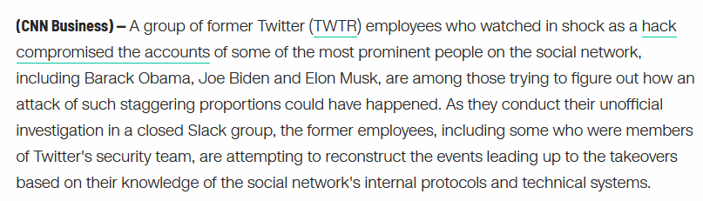
And…
We haven’t even mentioned hackers and data breaches

Slide 14
How Can It Affect You?
Job Search
Job screenings
College Applications & Scholarships
Lies can turn up online
Harvard University example
Notes:
70% of companies use soial media in job screenings
Harvard revoked acceptance for 10 applications after finding postings in a Facebook group
Included jokes about the Holocaust and abusing children
Insulting remarks about members of racial and ethnic groups

Slide 15
Security Hardening
Activity: Google Search
Search Google for your name, in quotes followed by your state
I would search “Eric Cameron” NJ
Search images.google.com for the same thing
I would search “Eric Cameron” NJ
* Try a family member if you don’t find yourself

Slide 16
Security Hardening
Activity: Public Records
http://www.mylife.com
http://www.peekyou.com
http://www.spokeo.com
* Try a family member if you don’t find yourself

Slide 17
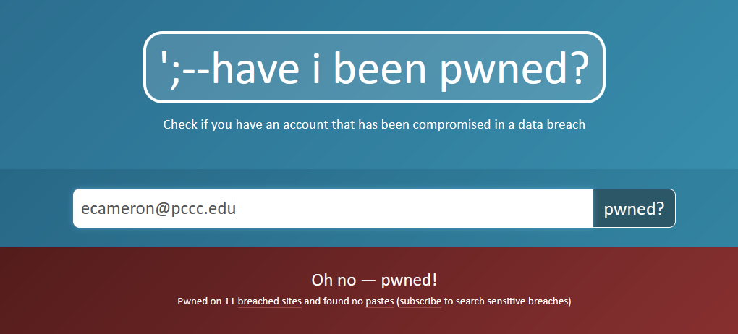
Security Hardening
Activity:
http://www.HaveIBeenPwned.com

Slide 18
What to Do?
BE MORE PARANOID
Opt out of sites like mylife, peekyou, spokeo
Yes, it’s a pain
Delete old accounts
Don’t use Facebook/Twitter/Tumblr/Reddit/Pinterest anymore? Deactivate or Delete.

Slide 19
What to Do?
Don’t use the same email everywhere!
Be careful with passwords
Post like your future boss is reading (because they may be)

Slide 20
Breakout Rooms
After Break, breakout rooms.
Unmute and discuss the first three activities!
Did you find anything for you or your family on Google, PeekYou/MyLife/Spokeo, or HaveIBeenPwned?
Any solutions?

Slide 21
About Me
Eric Cameron
ecameron@pccc.edu
www.linkedin.com/in/ericcameron
www.youtube.com/c/ericcameron

